Slide 1
Day 07
Denavit-Hartenberg

Slide 2
Denavit-Hartenberg

Slide 3
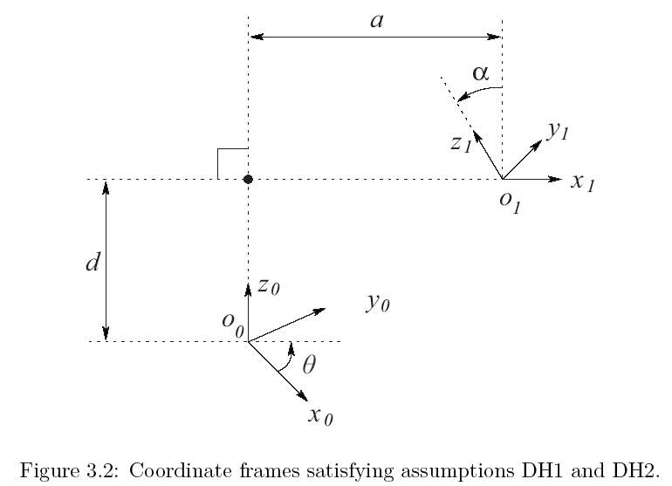
Denavit-Hartenberg

